Slide 1
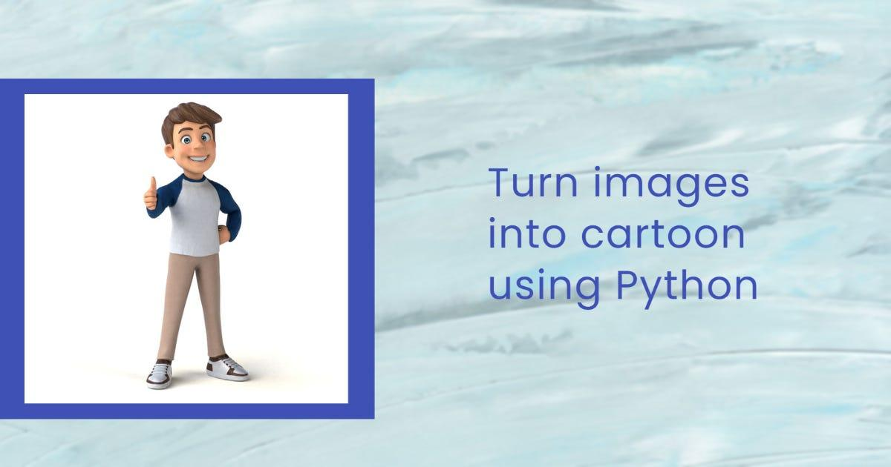
CARTOONING AN IMAGE USING OPEN CV -PYTHON

Slide 2
TEAM MEMBERS:
K SAI MOHITH(192125038)
A V NAGA KAVYA(192125034)

Slide 3
ABSTRACT
Cartoonization involves transforming a regular image into a stylized cartoon representation. The Python code that we used employs the OpenCV library to implement a cartoonization process for images. The code encompasses steps such as edge detection through adaptive thresholding and the application of a bilateral filter to achieve a balance between smoothing and edge preservation. The resulting cartoonized image is a visually appealing and artistic rendition of the original photograph, showcasing the capabilities of computer vision techniques in image processing using the Python programming language.

Slide 4
INTRODUCTION
Cartooning an image is a popular technique used in the world of digital art and animation.
It involves transforming a photograph or a realistic image into a simplified, cartoon-like version.
This technique is widely used in various industries such as animation, advertising, and even social media filters.
In this blog post, we will explore how to cartoon an image using OpenCV-Python.
OpenCV (Open Source Computer Vision) is an open-source library that provides a wide range of image processing and computer vision algorithms.

Slide 5
It is widely used in various fields, including robotics, augmented reality, and digital image processing. With its powerful features and easy-to-use interface, OpenCV has become a popular choice for many developers and artists.
The first step in cartooning an image is to detect the edges in the image.
After detecting the edges, the next step is to reduce the number of colors in the image.
This process is called color quantization, which helps in simplifying the image and giving it a more cartoonish look.

Slide 6
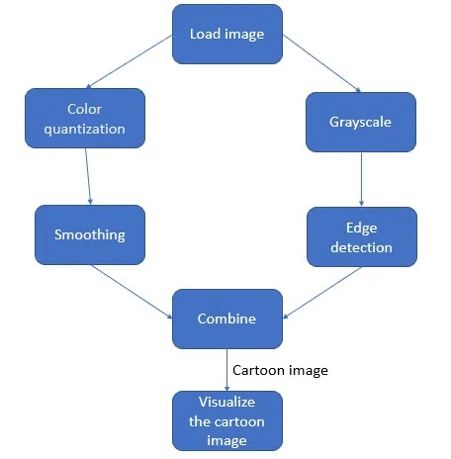
Finally, we need to apply a few image processing techniques to give our image a cartoon effect.
This can be achieved by applying a median filter to smooth out the edges and adding a thick stroke around the edges using a threshold function.
These techniques help in giving the image a cartoon-like appearance.

Slide 7
MATERIALS
OpenCV Library:
OpenCV (Open Source Computer Vision) is a popular open-source computer vision and image processing library. It provides various functions and tools for image manipulation, analysis, and transformation.
NumPy Library:
NumPy is a fundamental package for scientific computing with Python. It is used for numerical operations and array manipulations, often employed in image processing tasks.
Image File:
The code assumes the existence of an image file named “image.png." This is the input image that will undergo the cartoonization process.

Slide 8
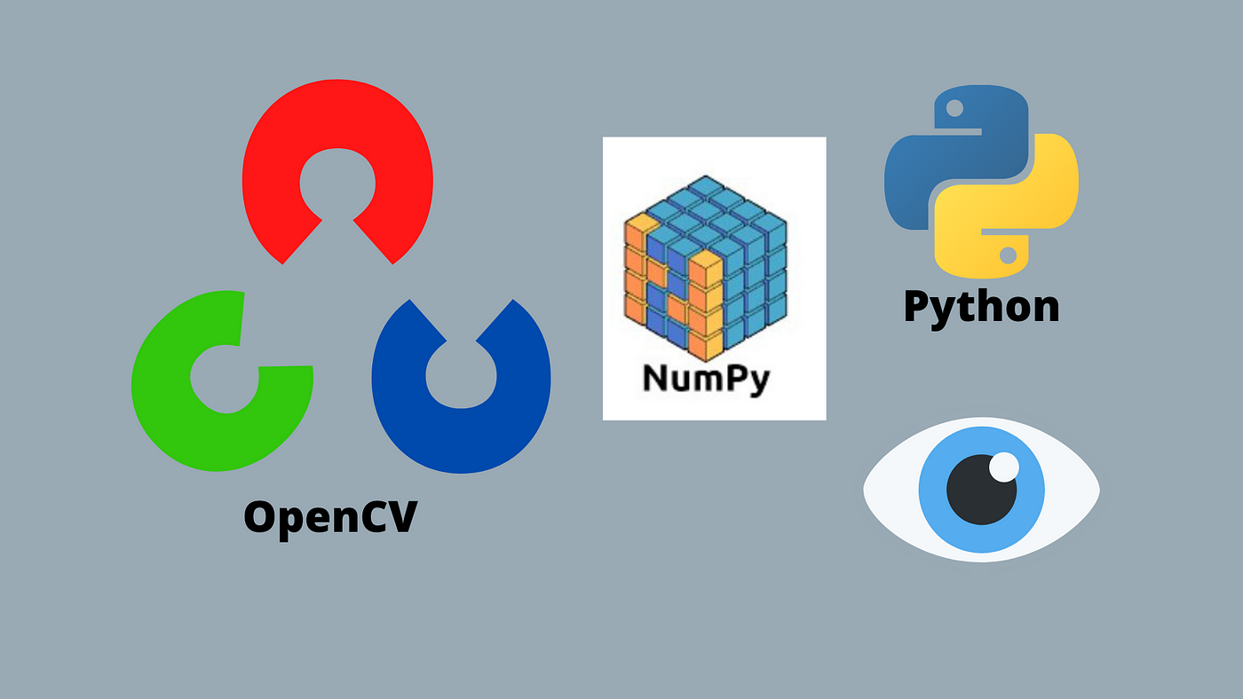

Slide 9
METHODS
Image Reading:
The cv2.imread function is used to read the input image (“image.jpeg").
Edge Detection:
Convert the image to grayscale using cv2.cvtColor.
Apply median blur to the grayscale image using cv2.medianBlur.
Perform edge detection using adaptive thresholding with cv2.adaptiveThreshold.
Cartoonization:
Apply a bilateral filter to the original image using cv2.bilateralFilter. This filter smoothens the image while preserving edges.

Slide 10
Obtain the cartoonized image by performing a bitwise AND operation (cv2.bitwise_and) between the filtered color image and the edge-detected binary image.
Display Results:
Display the original image, edge-detected image, and cartoonized image using cv2.imshow.
User Interaction:
Wait for a keyboard event with cv2.waitKey(0) before closing the displayed images.
Close all open windows using cv2.destroyAllWindows().

Slide 11
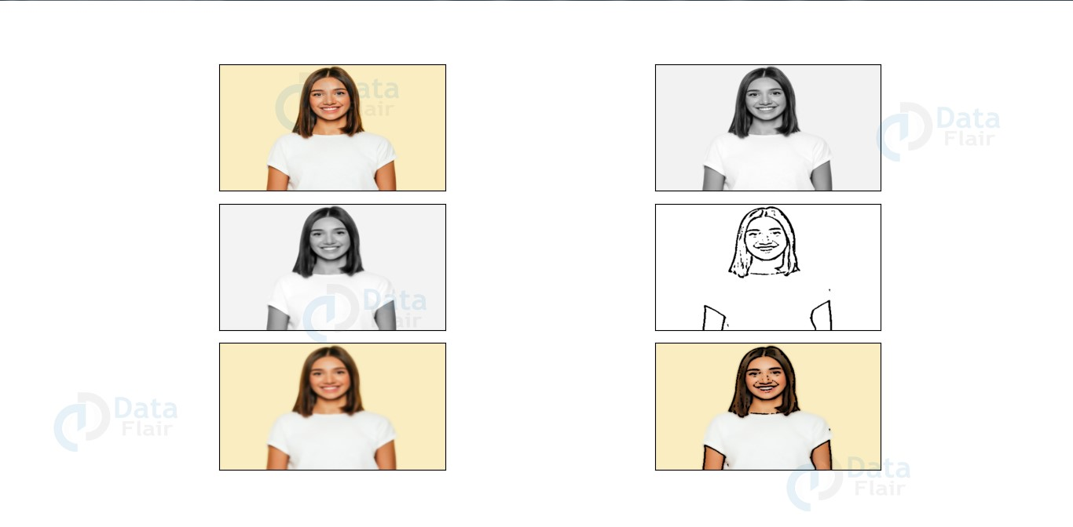

Slide 12
DISCUSSIONS
In this Python code utilizing OpenCV for image cartoonization, the chosen method involves adaptive thresholding for edge detection and a bilateral filter for achieving a balance between image smoothing and edge preservation. The selection of these techniques raises interesting discussions regarding their impact on the final output. Adaptive thresholding is employed for its adaptability to varying image contexts, and the bilateral filter's parameters, such as filter size and sigma values, play a crucial role in determining the visual quality of the cartoonized image. The success of the cartoonization process is contingent on how well these techniques synergize.

Slide 13
RESULTS
The visual results of the cartoonization process showcase a sequence of transformations, including the original image, the edge-detected representation, and the final cartoonized output. The edge-preserving properties of the bilateral filter contribute to sharp outlines and distinct features in the cartoonized image, while adaptive thresholding accentuates edges. The effectiveness of the cartoonization process can be visually assessed based on factors such as color vibrancy, edge clarity, and overall aesthetic appeal.

Slide 14
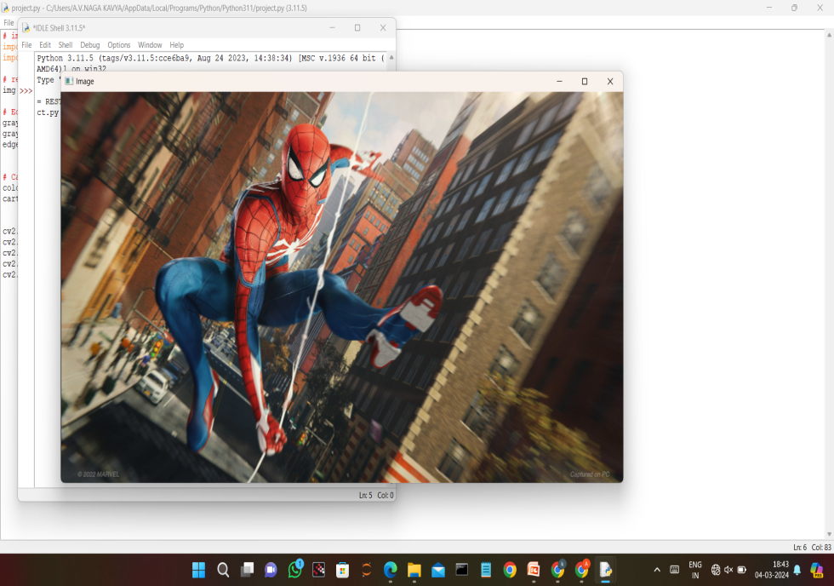
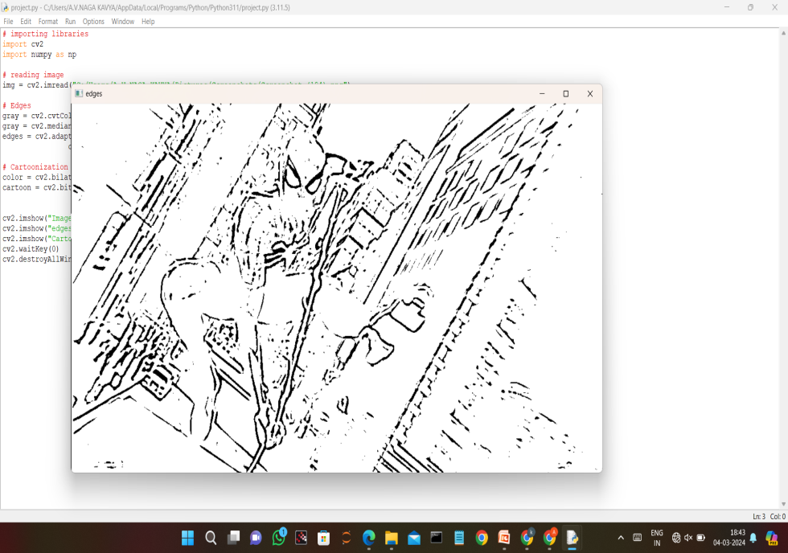
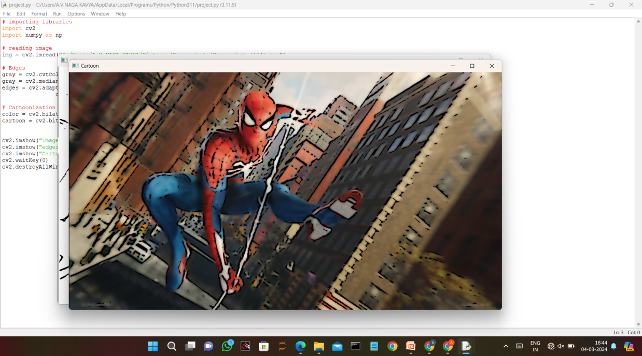

Slide 15
CONCLUSION
The implemented cartoonization technique demonstrates its ability to transform standard images into visually appealing cartoon-like representations.
The method's adaptability to different image types and its potential applications in artistic rendering or graphic design are noteworthy.
Discussions on potential improvements, alternative algorithms, and considerations for diverse image content contribute to a comprehensive understanding of the strengths and limitations of the implemented approach.
This cartoonization method stands as a valuable tool for stylized image creation, offering both technical and artistic merit.

Slide 16
SCOPE
The scope of the implemented image cartoonization code using OpenCV in Python encompasses various areas, reflecting both its current capabilities and potential applications.
Artistic Rendering:
The cartoonization process is particularly suitable for artistic rendering, providing a visually appealing and stylized representation of images. It can be employed in graphic design, digital art creation, and other creative endeavors where a cartoon-like aesthetic is desired.

Slide 17
Entertainment and Media:
The cartoonization technique could find applications in the entertainment industry, including video production, animation, and gaming. It may be utilized to create cartoon-style characters or scenes, adding a unique and engaging visual element to multimedia projects.
User Interface Design:
The stylized output from the cartoonization process might be incorporated into user interface design, enhancing the visual appeal of applications, websites, or interactive media.

Slide 18
Educational Tools:
The code could serve as an educational tool for teaching image processing concepts. It provides a practical example of edge detection and bilateral filtering techniques, offering insights into their application in computer vision.
Image Enhancement:
Beyond artistic applications, the cartoonization process might be used as a tool for image enhancement. It can emphasize prominent features and details in images, potentially aiding in image analysis or emphasizing specific elements in photographs.

Slide 19
Research and Development:
The cartoonization code can be a starting point for further research and development in image processing. Researchers and developers may explore modifications, alternative algorithms, or parameter tuning for specific applications or improved results.
Customization and Integration:
The code can be customized and integrated into larger projects or workflows that involve image processing. For instance, it can be incorporated into image editing software or integrated into pipelines for automated image processing.

Slide 20
REFERENCES
https://www.geeksforgeeks.org/cartooning-an-image-using-opencv-python/
https://data-flair.training/blogs/cartoonify-image-opencv-python/
https://www.analyticsvidhya.com/blog/2022/06/cartoonify-image-using-opencv-and-python/
https://www.jetir.org/view?paper=JETIR2305C40

